Slide 1
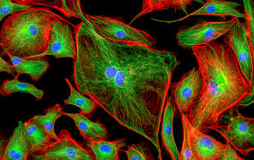

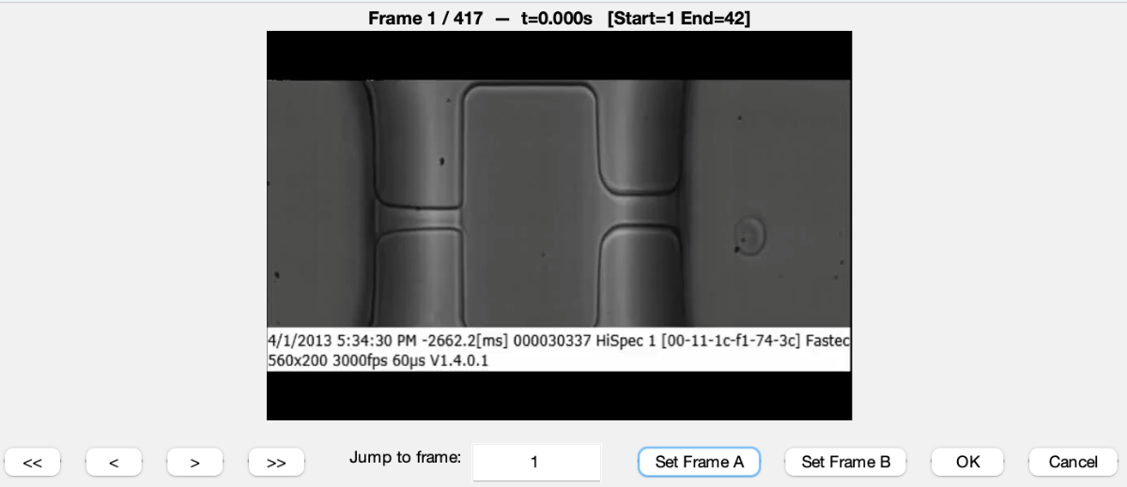
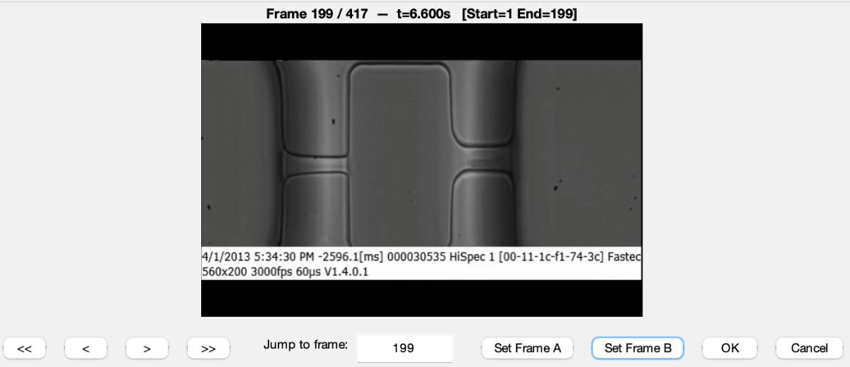

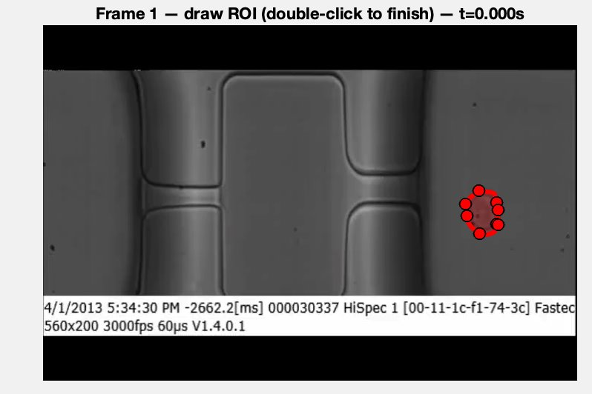
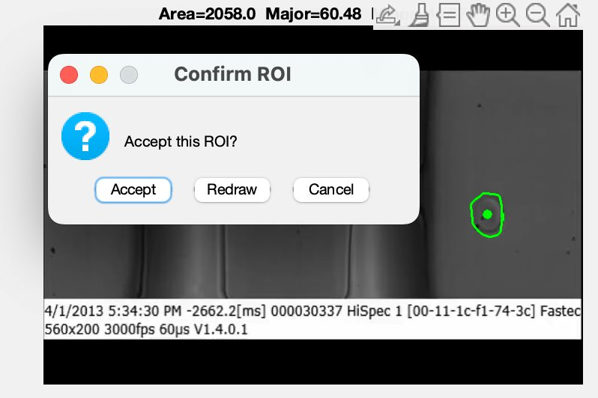
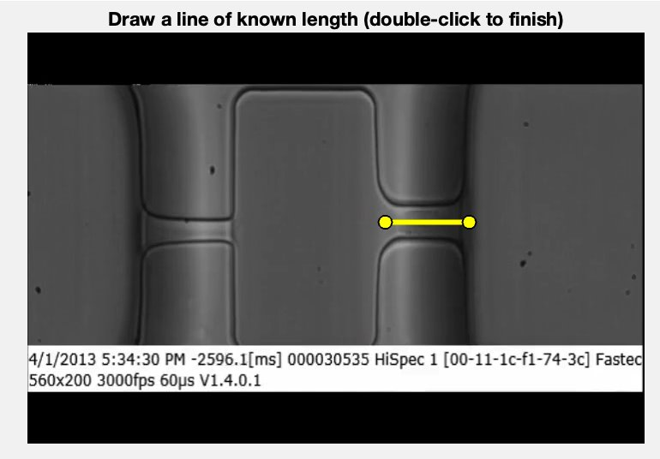
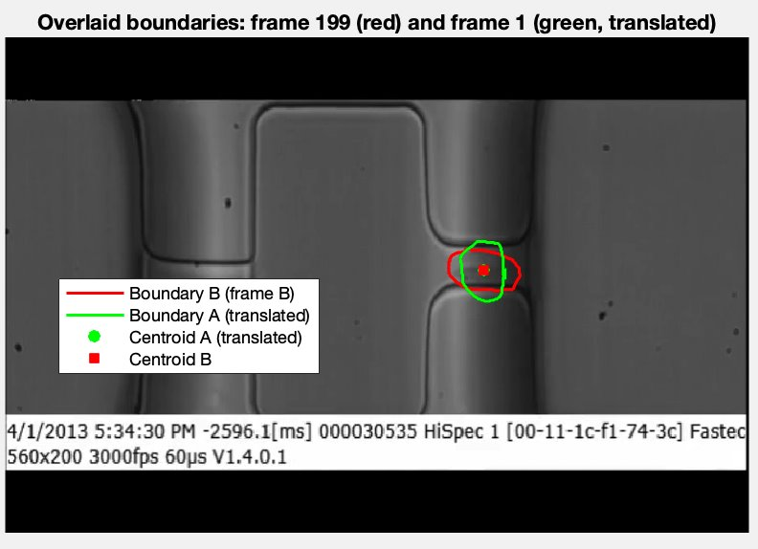
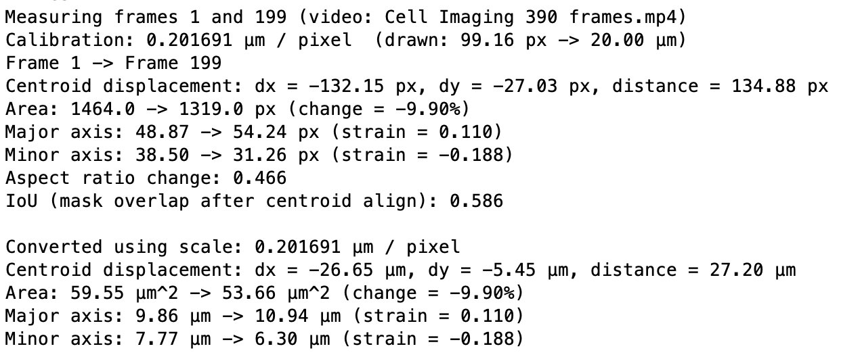
Cell Imaging
Team members: Demetrius Schank, John Ann, Jonathan Kim | Advisor: Dr. Rosalind Wynne
Results and Testing
Introduction
Cell imaging is the visualization and observation of cells and its properties. It is important because it allows detection of functions and abnormalities within cells. This allows scientists and researchers to understand cells better and can be used to discover and develop medicine more efficiently.
Analysis Process Visualized
Test | C/C/S/S
Cell Detection Test | Constraint: Discern cell boundaries within a 2D space Specification: Detection of cell borders
Cell Deformation Rate Test | Constraint: Accuracy Specification: Cell deformation
Second Sample Test | Constraint: Applicability Criteria: Reproducibility Criteria: Multi-Codec compatibility
Compliance Test | Standard: MISRA C standards
Ease of Usability Test | Constraint: User Friendly
Goal
The group was tasked with selecting a specific cellular property to detect and quantify. The 2024–2025 cell imaging team focused on measuring cellular velocity, and the 2025–2026 team investigated cell deformation within capillaries. This focus is significant because the flexibility of cells is indicative of their health and their ability to adapt to varying physiological conditions.
Choose two frames of interest
Draw region of interest, and confirm or redraw
(both frames separately)
Analysis Process
The platform that was used to measure cell deformation was MATLAB. First, a video is selected of a cell going through a channel and deforming. Then, the user has the option to choose any two instances in the video to analyze the shape of the cell, whether it be before, during, or after its deformation. After the two frames are selected, the user draws a handmade mask over the outline of the cell. Using the MATLAB Image Processing Toolbox, it analyzes the total area of the cell, its major and minor axis, and aspect ratio. The results are given in the MATLAB Command Window. In addition to these results, the user has the optional step of defining a set length in the video, to convert the results from pixels into real units.
If available, draw a line of known length
Receive a visual representation as well as an analysis of cell deformation
Future Goals
The current design requires users to select two frames and manually outline cell boundaries, which can introduce human error and inconsistency. A primary future goal is to enable users to upload videos and have the system automatically track cells across frames, allowing for more accurate and flexible analysis between any selected frames.
We would like to thank: Dr. Klein, Dr. Wynne, Graduate Researcher Jiahaw Fu, The 2025 Cell Imaging Team,
as well as all our interviewees (Dr. Izzetoglu, Dr. Xun Jiao, and Jasmine Soriano)

